Slide 1
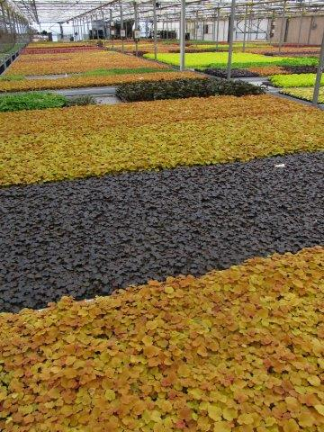
Heuchera, Always available in large quantities
Pioneer Gardens, Inc. – 2019 – 2020

Slide 2
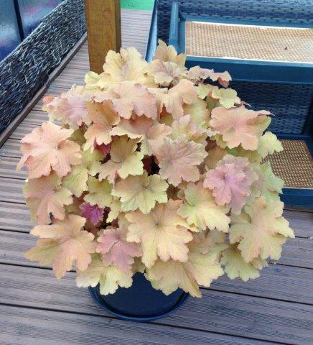
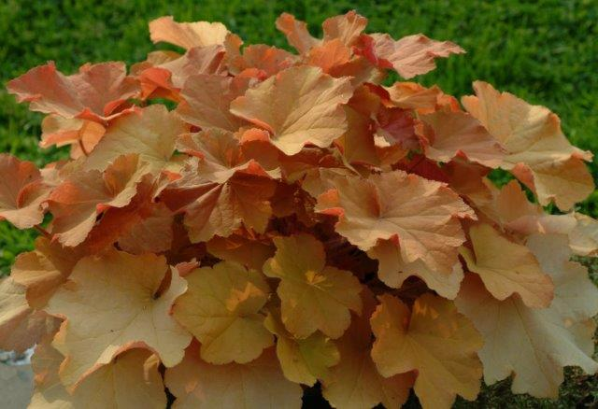
Heuchera ‘Caramel’
‘Caramel’ Spring colors
‘Caramel’, late summer/fall colors
Pioneer Gardens, Inc. – 2019 – 2020

Slide 3
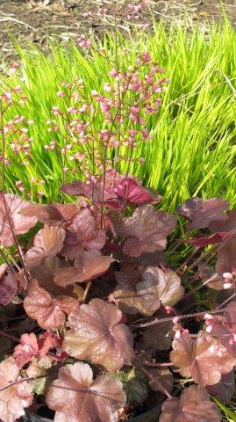
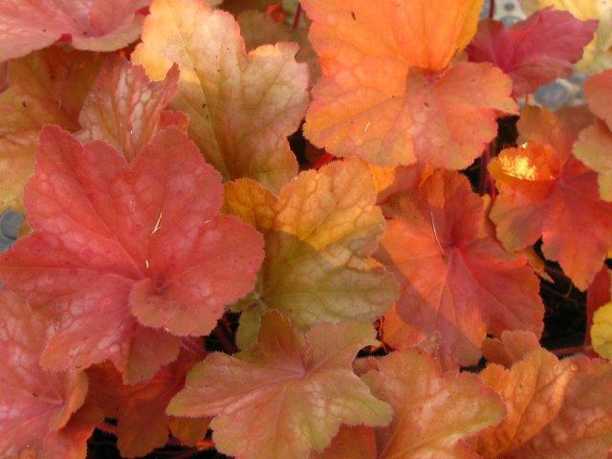
Heuchera (Orange – Gold)
Orange Dream (NEW)
Brown Sugar
Pioneer Gardens, Inc. – 2019 – 2020

Slide 4
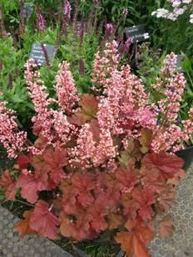
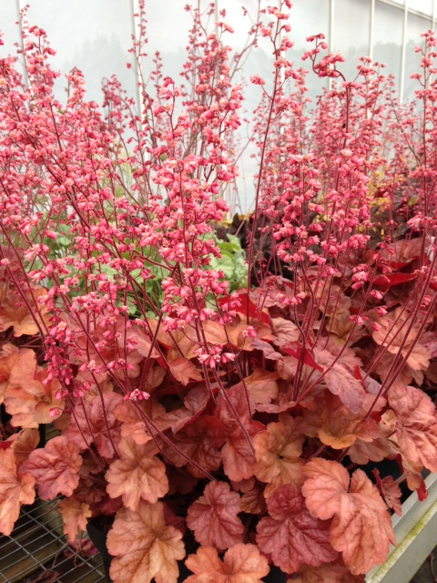
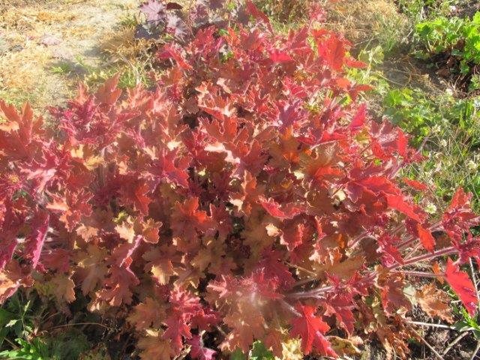
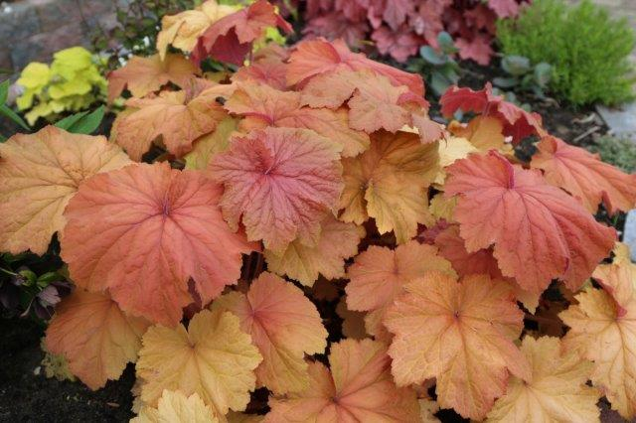
Heuchera (Orange-Gold continued)
< Pink Pearls (NEW)
Apricot (NEW) >
Mega Caramel (NEW)
‘Mango’ (NEW, extremely hardy, tough and drought-resistant. Only spreading groundcover Heuchera!)
Pioneer Gardens, Inc. – 2019 – 2020

Slide 5
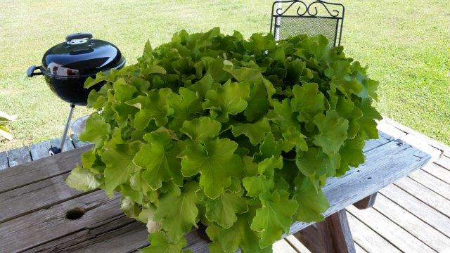
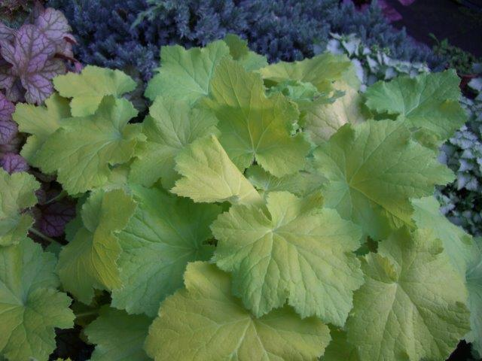
Heuchera (Lime-Green Types)
Guacamole->
Pistache
Pioneer Gardens, Inc. – 2019 – 2020
Happy Moon

Slide 6
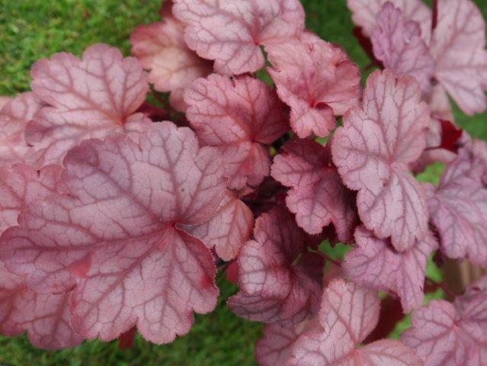
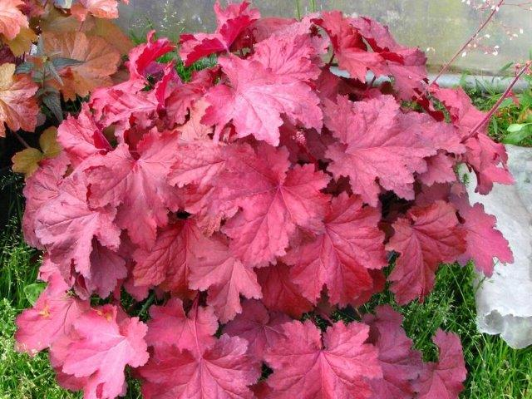
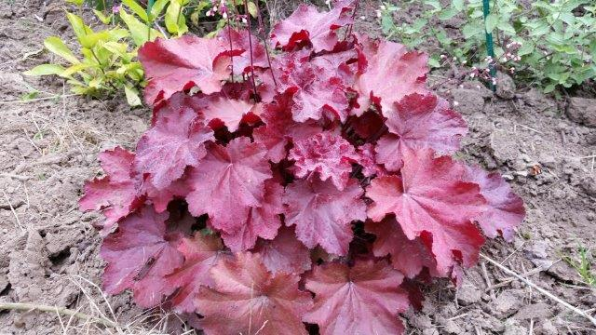
Heuchera (Pink-Red Types)
Raspberry Sea (NEW) >
Magma (Arjen’s favorite new Heuchera)
Carmencita in the landscape >
Pioneer Gardens, Inc. – 2019 – 2020

Slide 7
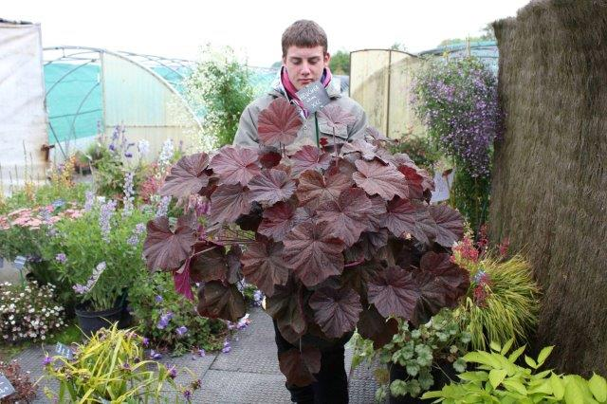
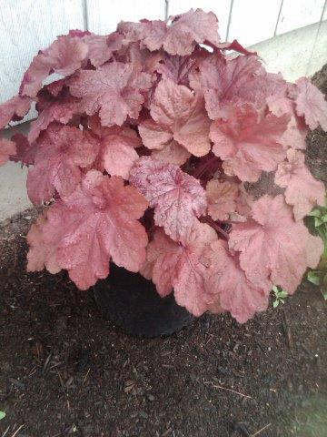
Heuchera Pink-Red Types (continued)
Cloud Nine (NEW)
Pinot Gris >
Beaujolais
Pioneer Gardens, Inc. – 2019 – 2020

Slide 8
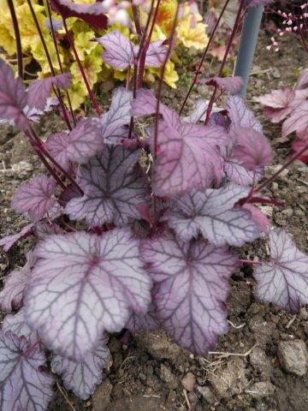
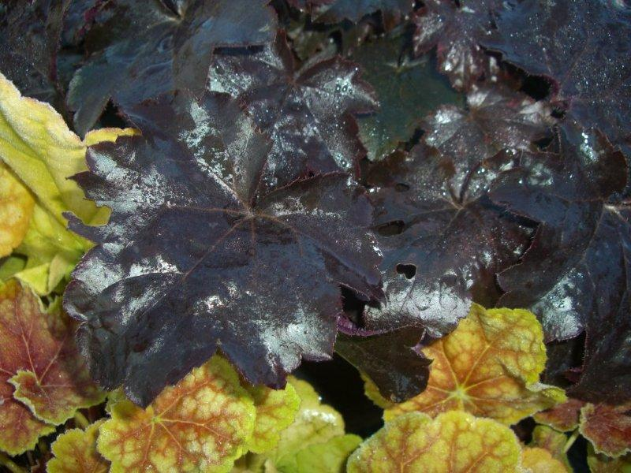
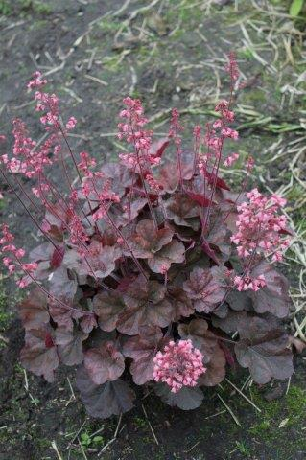
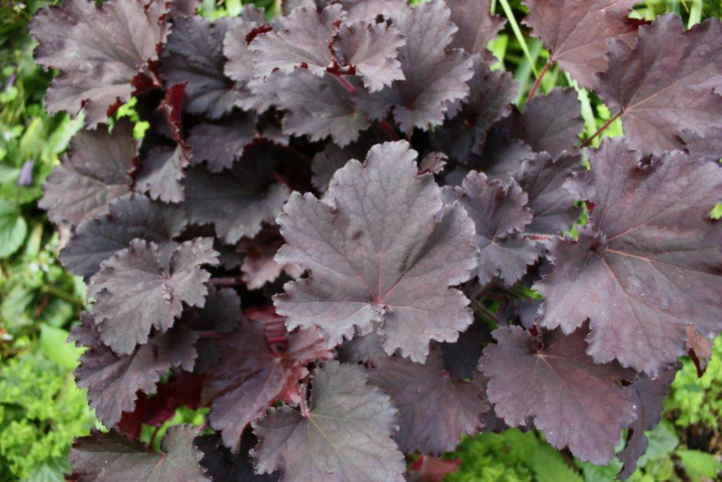
Heuchera (dark colors)
<-Flower Tower
Blackout
Binoche
<-Cassis
Frosted Violet ->
Pioneer Gardens, Inc. – 2019 – 2020

Slide 9
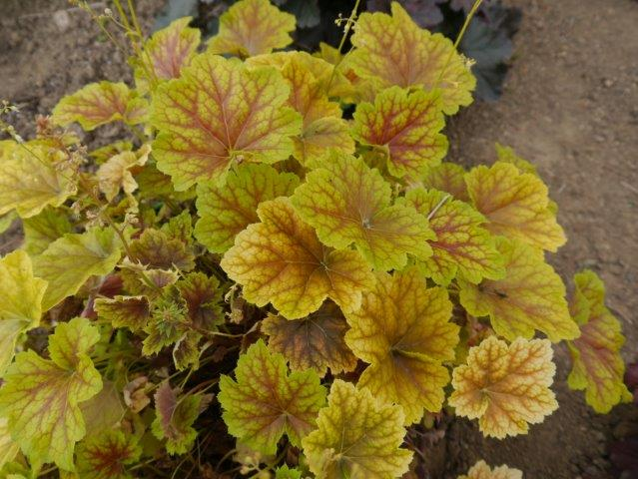
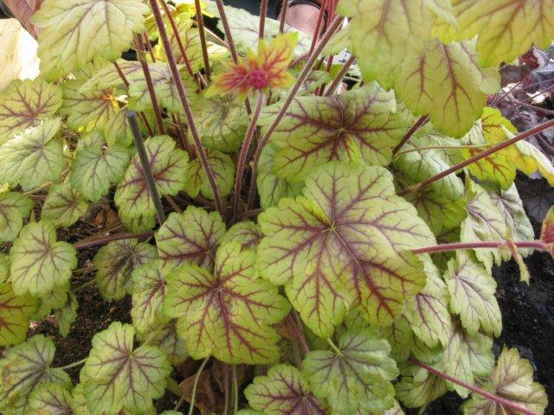
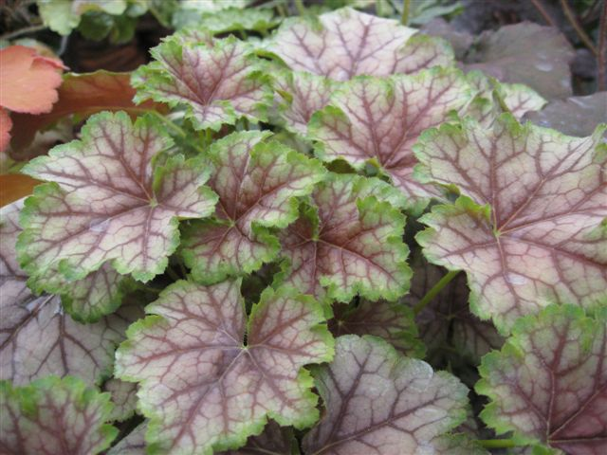
Heuchera (Multi-Color Types)
Happy
Flames
Miracle
Birkin
Circus
Pioneer Gardens, Inc. – 2019 – 2020

Slide 10
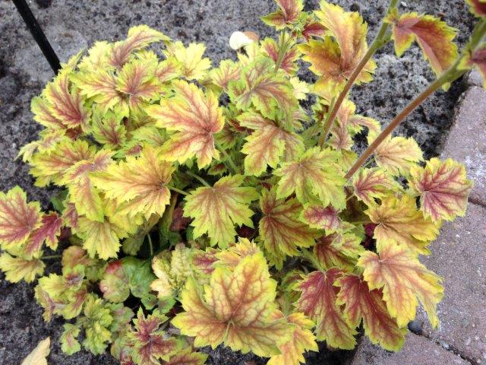
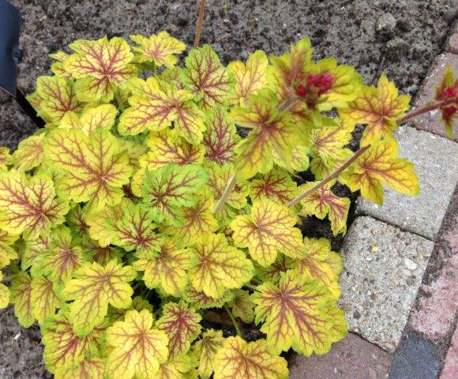
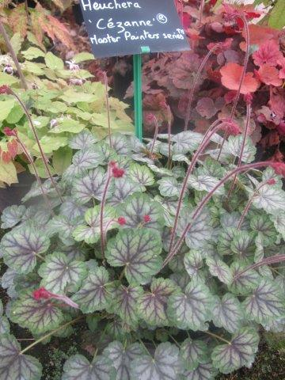
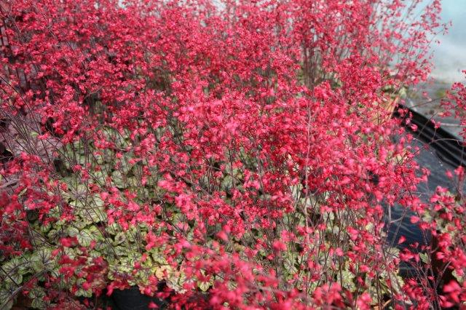
Heuchera Master Painters Series
Renoir
Van Gogh
Cezanne in Bloom
Cezanne (NEW) >
Pioneer Gardens, Inc. – 2019 – 2020

Slide 11
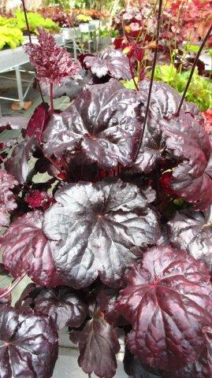
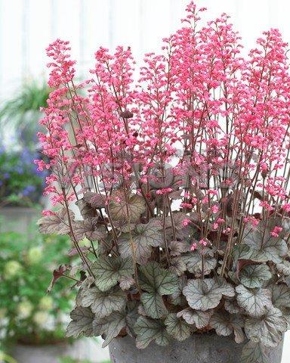
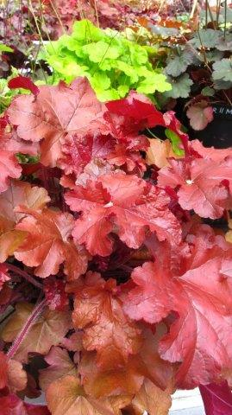
‘Black Sea’ - ‘Flores Sea’ - ‘Red Sea’
Pioneer Gardens, Inc. – 2019 – 2020

Slide 12
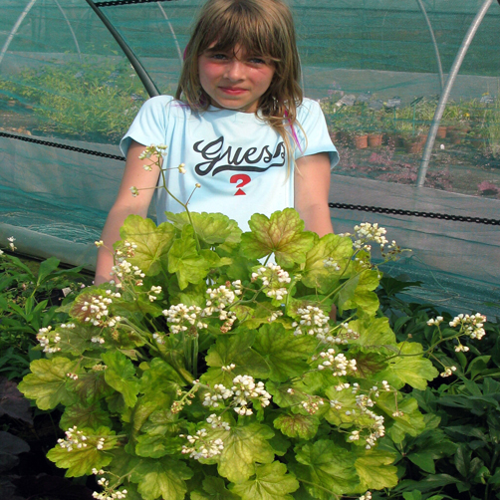
The Giants!
Mega Caramel
Pretty Perrine
Cloud Nine
Magma
Guacamole
Pioneer Gardens, Inc. – 2019 – 2020

Slide 13
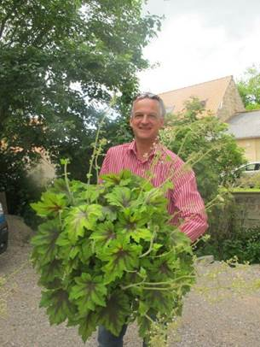
Heucherella ‘Art Nouveau’
Pioneer Gardens, Inc. – 2019 – 2020

